Slide 1


The Impact of CO2 Emission on Sales of New Light-duty Vehicles
CSE 704 – Data Visualization and Processing
Group 1
Joan Ejeta
Dequante Mckoy
Nikita Agarwal

Slide 2
Outline
Background/Aims
Objectives
Methodology
Predictive Analysis of CO2 Emission & Car Prices

Slide 3
Background/Aims
Climate change is the greatest long-term threat that we face as a global community.
Hence the transport sector can be considered as a contributor to the amount of C02 emissions in the atmosphere.
Aims: Build a prediction model of C02 emissions of light vehicles for a period of 10 years and its impact on the pricing of vehicles using carbon tax.

Slide 4
Objectives
Which cars are likely to emit more CO2 as the year progresses?
At what rate is the cars sales price increasing/decreasing in relation with C02 emissions
Which car model and model features has high C02 emission?
Which variables are significant in predicting the CO2 emission. Can we infer a trend?

Slide 5
Methodology
Data Collection
Data Processing – data cleaning, remove redundant data, remove outliers
Analyze data with descriptive statistics
Data visualization
Feature selection
Model building

Slide 6
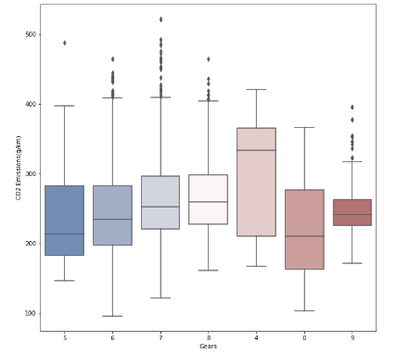
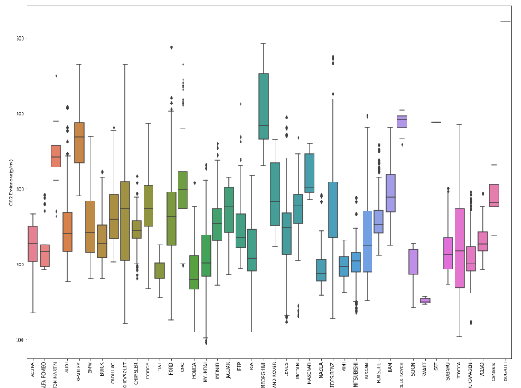
Outliers detection

Slide 7
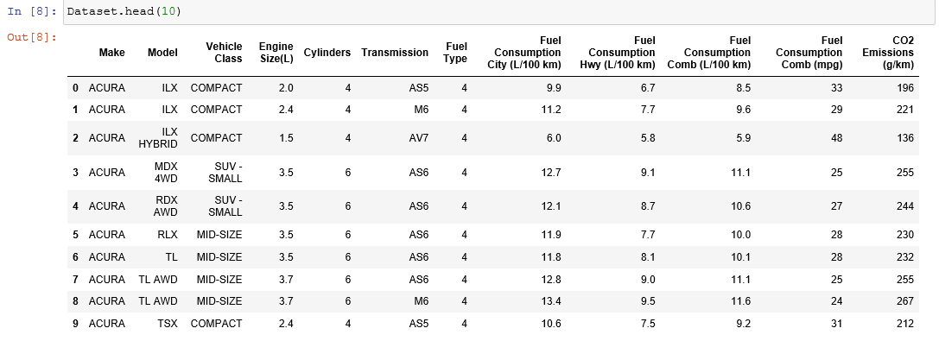
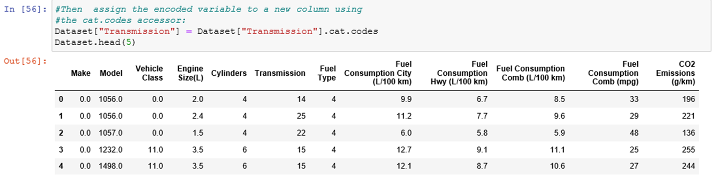
Data before cleaning
Data after cleaning

Slide 8
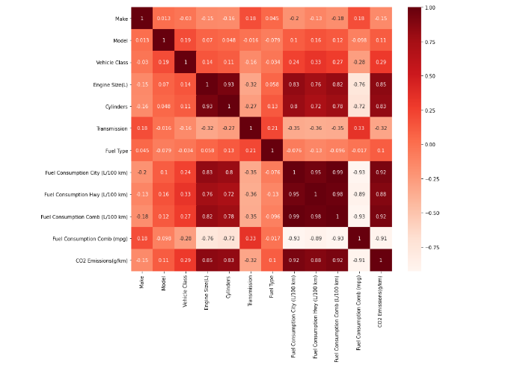
Correlation Matrix for Feature Selection
Fuel consumption on combo
Fuel consumption in city
Fuel consumption on highway
Engine size
Cylinders

Slide 9

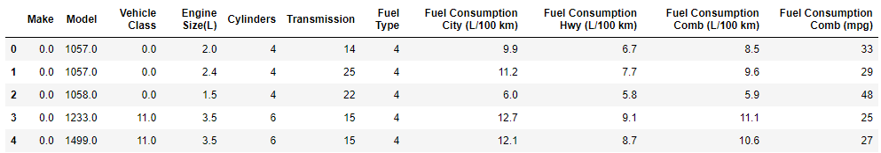
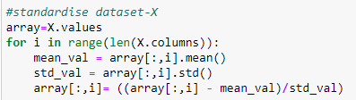
Split data/ Standardizations
After Splitting the dataset, we decided to drop CO2 Emission column to use for our y-test dataset
The next step of our project was for us to standardize the original dataset after dropping CO2 Emissions column

Slide 10
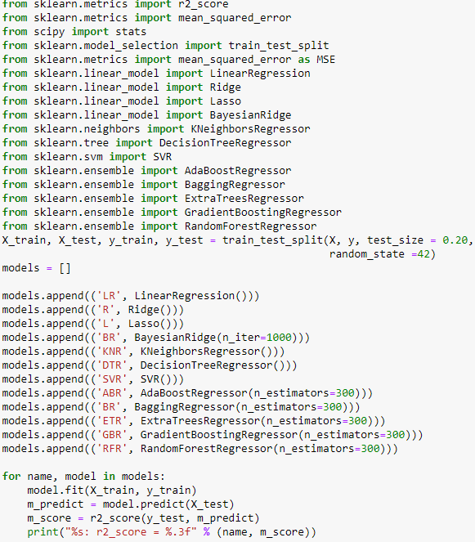
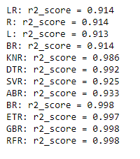
Model Evaluation of CO2 Emission of Car Models
After standardizing the dataset, we then ran a model evaluation of CO2 Emission of the models and Vehicle Class
After performing the Model evaluation, we were able to see that Extra Tree Regressor (ETR) was the most significant with 0.997 r2 score

Slide 11
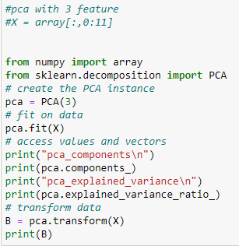
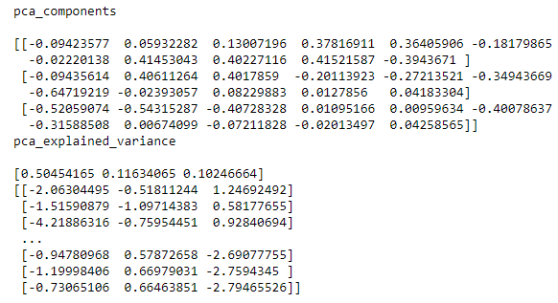
PCA with 3 features selected
We decided to run a principal component analysis using 3 features.

Slide 12
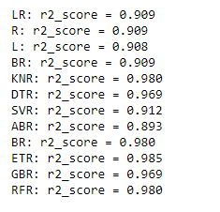
R2 score after Principal Component Analysis(PCA)
After applying the pca component we were able to notice that our R2 score for Extra Tree Regressor (ETR) has the highest value.

Slide 13

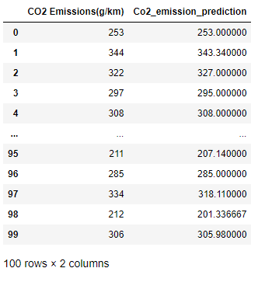
Extra Tree Regressor (ETR)
After applying the PCA, we were able to obtain the CO2 Emission and CO2_Emission _prediction columns.
After evaluating the data, we were able to show predictions of CO2_Emission_ prediction for each following year after 2021

Slide 14
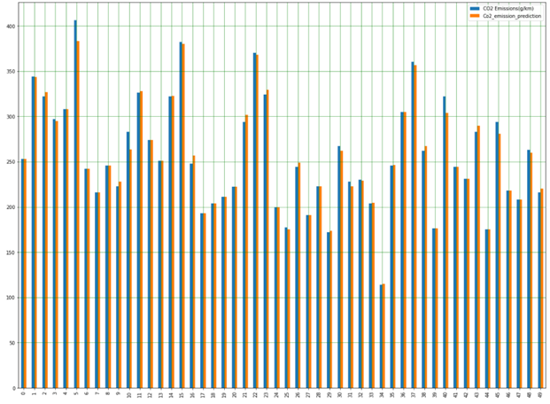
CO2 Emission vs CO2 Emission Prediction

Slide 15
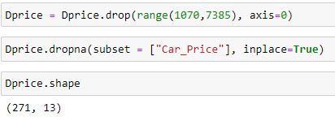
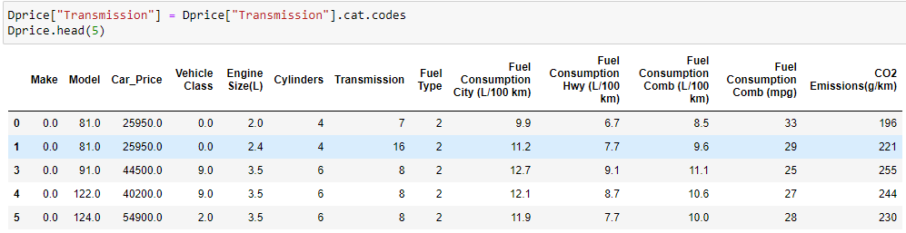
Price Prediction Analysis
Our next step was to evaluate the Car_Price of Vehicles
We need to reduced the dataset to only show the different models of vehicles only once
After reshaping the data set we were able to see that was 271 rows and 13 columns compared to the original dataset of 7385 rows and 12 columns.

Slide 16
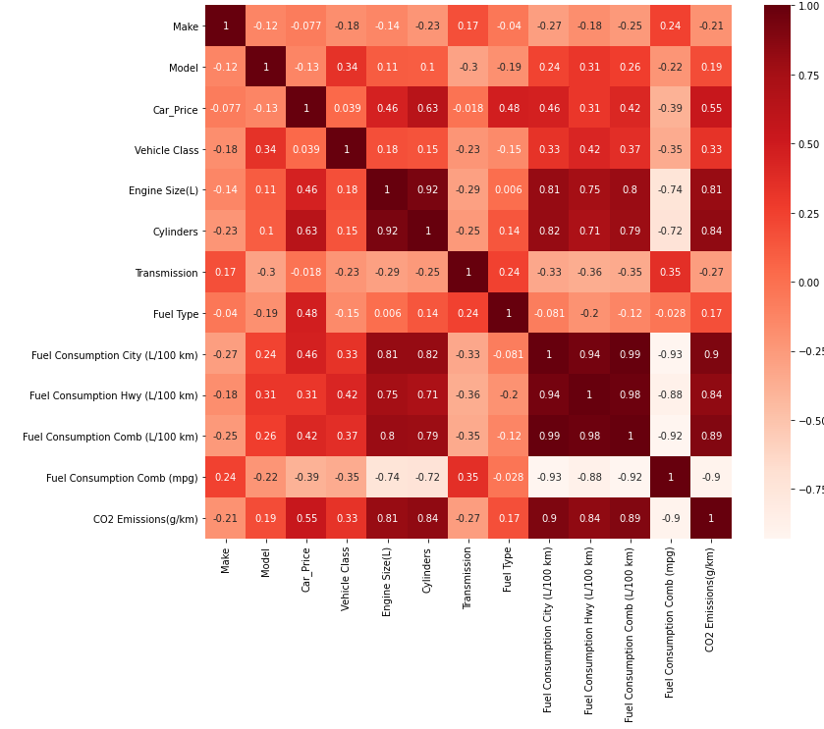
Correlation Matrix with Car Price Data
We were able to see significant correlation with Car_Price & CO2 Emission

Slide 17
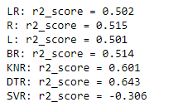
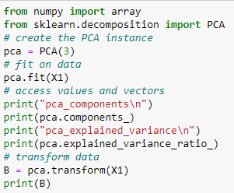
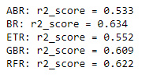
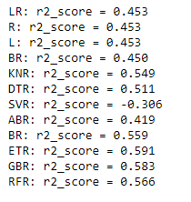
Model Testing Before & After PCA Test
Before PCA Test
After performing Model testing with Car_price column added we were able to see an significant r2_score for ETR with 0.591
After performing PCA Test we still noticed a significant r2_score of ETR but also GBR r2_score as well
The reasoning for such a low r2_score is because when we lowered our data set it caused a significant change within the accuracy of the dataset.
After PCA Test

Slide 18
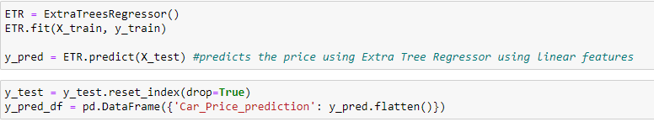
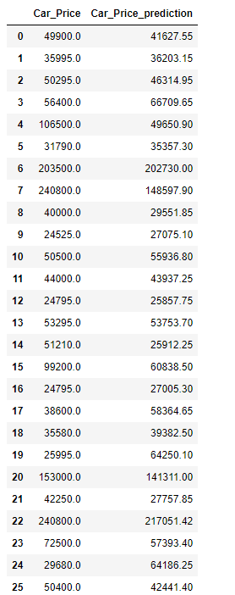
Extra Tree Regressor (ETR)
We decided to further into the Extra Tree Regressor to help predict the prices of vehicles using the linear features
We were able to get the Car_Price and Car_Price_Prediction columns showing as the CO2 Emission rises the vehicle will rise every year following 2021

Slide 19
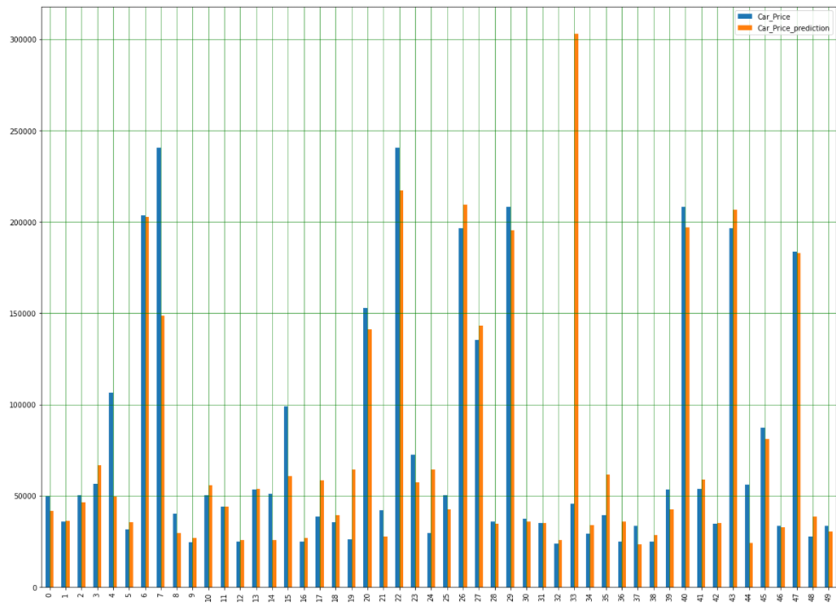
Comparison Chart Car Prices Predictions Analysis

Slide 20
Conclusion
We can conclude that after testing our dataset and using the different regression models and standardization of the dataset, we were able to see a significant correlation between CO2_Emission & Car_Price with regression model Extra Tree Regressor (ETR).
The luxury cars such as Lamborghini, Bentley and Jaguar had the highest amount of CO2 emission in our dataset.
Finally, after performing PCA on CO2_Emission and Car_Price we were able to build a Comparison Chart for Predicting the CO2_Emission and Car_Price for each year.
The car sales price increased by 1% with an increase in C02 emission per year. As CO2_Emission increase each year they’ll be a direct correlation to Car_Price data increasing as well.

